Slide 1
Project
presentation

Slide 2
ACROSS at a glance
Project title
Towards user journeys for the delivery of cross-border services ensuring data sovereignty.
Call and topic
H2020-SC6-GOVERNANCE-2020
DT-GOVERNANCE-05-2018-2019-2020 - New forms of delivering public goods and inclusive public services
Duration
Funding
Budget
Consortium
36 months
Start date 01.02.2021
RIA -
Research and Innovation action
10 partners
€ 3.998.312,50
This project has received funding from the European Union’s Horizon 2020 research and innovation programme under grant agreement No: 959157.

Slide 3
ACROSS
motivation

Slide 4
Project motivation
EUROPEAN UNION RESIDENTS
NATIONALITY
512 million persons living in the
European Union in 2018
7.8 % had a nationality other than their country of residence: 3.4 % had citizenship of another EU Member
STUDYING ABROAD
WORKING ABROAD
Studying aboard is increasingly common among students: In 2017, there were in total 1.7 million such mobile students in the EU coming from abroad, a number which has increased by 22 % since 2013.;
Working abroad has become more and more common in the EU: the employment rate for those with citizenship of another Member State than the one they were living in was 77% in 2018;
This project has received funding from the European Union’s Horizon 2020 research and innovation programme under grant agreement No: 959157.

Slide 5
What brought us here
PUBLIC ADMINISTRATIONS
CHALLENGES
Overcome the existing administrative, organizational, technological, and legal barriers in providing interoperable services
Ensure the availability, quality and interoperability of information about public services
EASY PROVISION OF CROSS-BORDER SERVICES
PUBLIC DEMAND
For a citizen to be able to gain free and easy access to (other) countries' e-services
PAs have to pay additional attention to provide the same possibilities of public services to both residents and non-residents
Users should be able to easily understand the administrative procedures
Citizens need to be sure that their personal data meet the EU’s strict data protection rules, and they are owners of their data
This project has received funding from the European Union’s Horizon 2020 research and innovation programme under grant agreement No: 959157.

Slide 6
Understand the project's vision

Slide 7
ACROSS PROJECT PRESENTATION
What do we want to do?
EXPLORE
Current European regulations (e.g. the Single Digital Gateway (SDG) and Once-Only principle (OOP), European Interoperability Framework (EIF).
FIND
New ways to enable user-centric design and implementation of interoperable cross-border (digital) public services as well as citizens’ data governance.
CONTRIBUTE
Setting up the tools and methods as well as the ecosystem enabling the implementation and experimentation of interoperable and cross-border public services;
Enabling & enhancing the collaboration among stakeholders;
Evaluating & validating ACROSS contribution to European policies’ implementation by ensuring its wider sustainability.
This project has received funding from the European Union’s Horizon 2020 research and innovation programme under grant agreement No: 959157.

Slide 8
ACROSS
objectives

Slide 9
ACROSS main objective
ACROSS MAIN OBJECTIVE
To provide a holistic solution that allows public administrations to deliver a user-centric interoperable cross-border mobility service compliant with the current European regulations (e.g., the Single Digital Gateway, European Interoperability Framework) where the private sector can also interconnect their services while ensuring the data sovereignty of the citizens, who can set the privacy level that will allow the public and private sector to access to his data based on his requirements.
This project has received funding from the European Union’s Horizon 2020 research and innovation programme under grant agreement No: 959157.

Slide 10
ACROSS specific objectives
ACROSS MAIN OBJECTIVE
OBJECTIVE 1
Implement a new governance model for the delivery of digital and mobile cross-border public services in the form of a ‘User Journey’
OBJECTIVE 2
Ensure the protection of personal data & its compliance with GDPR and other relevant regulations, especially when shared between organizations
OBJECTIVE 3
Analyse the transformative impact, potential, and benefits of interoperable, single-sign-on, cross-border and user-centric digital public services & foster a closer interaction between different stakeholders
OBJECTIVE 4
Validate ACROSS Measurable Outcomes in three (3) real use cases
OBJECTIVE 5
Develop a viable business model to ensure the sustainability of ACROSS
This project has received funding from the European Union’s Horizon 2020 research and innovation programme under grant agreement No: 959157.

Slide 11
ACROSS
approach

Slide 12
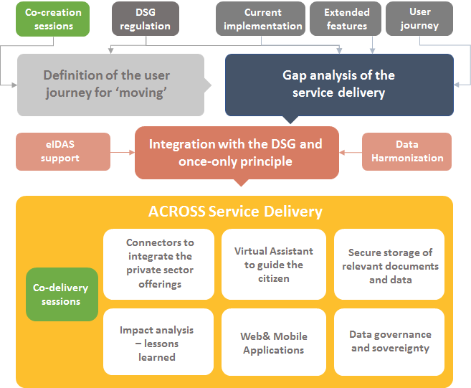
ACROSS PROJECT PRESENTATION
SDG
ACROSS
approach
SDG
The main objective of the ACROSS project is to provide the means (tools, methods and techniques) to enable user-centric design and implementation of interoperable cross-border (digital) public services compliant with the current European regulations.
This project has received funding from the European Union’s Horizon 2020 research and innovation programme under grant agreement No: 959157.

Slide 13
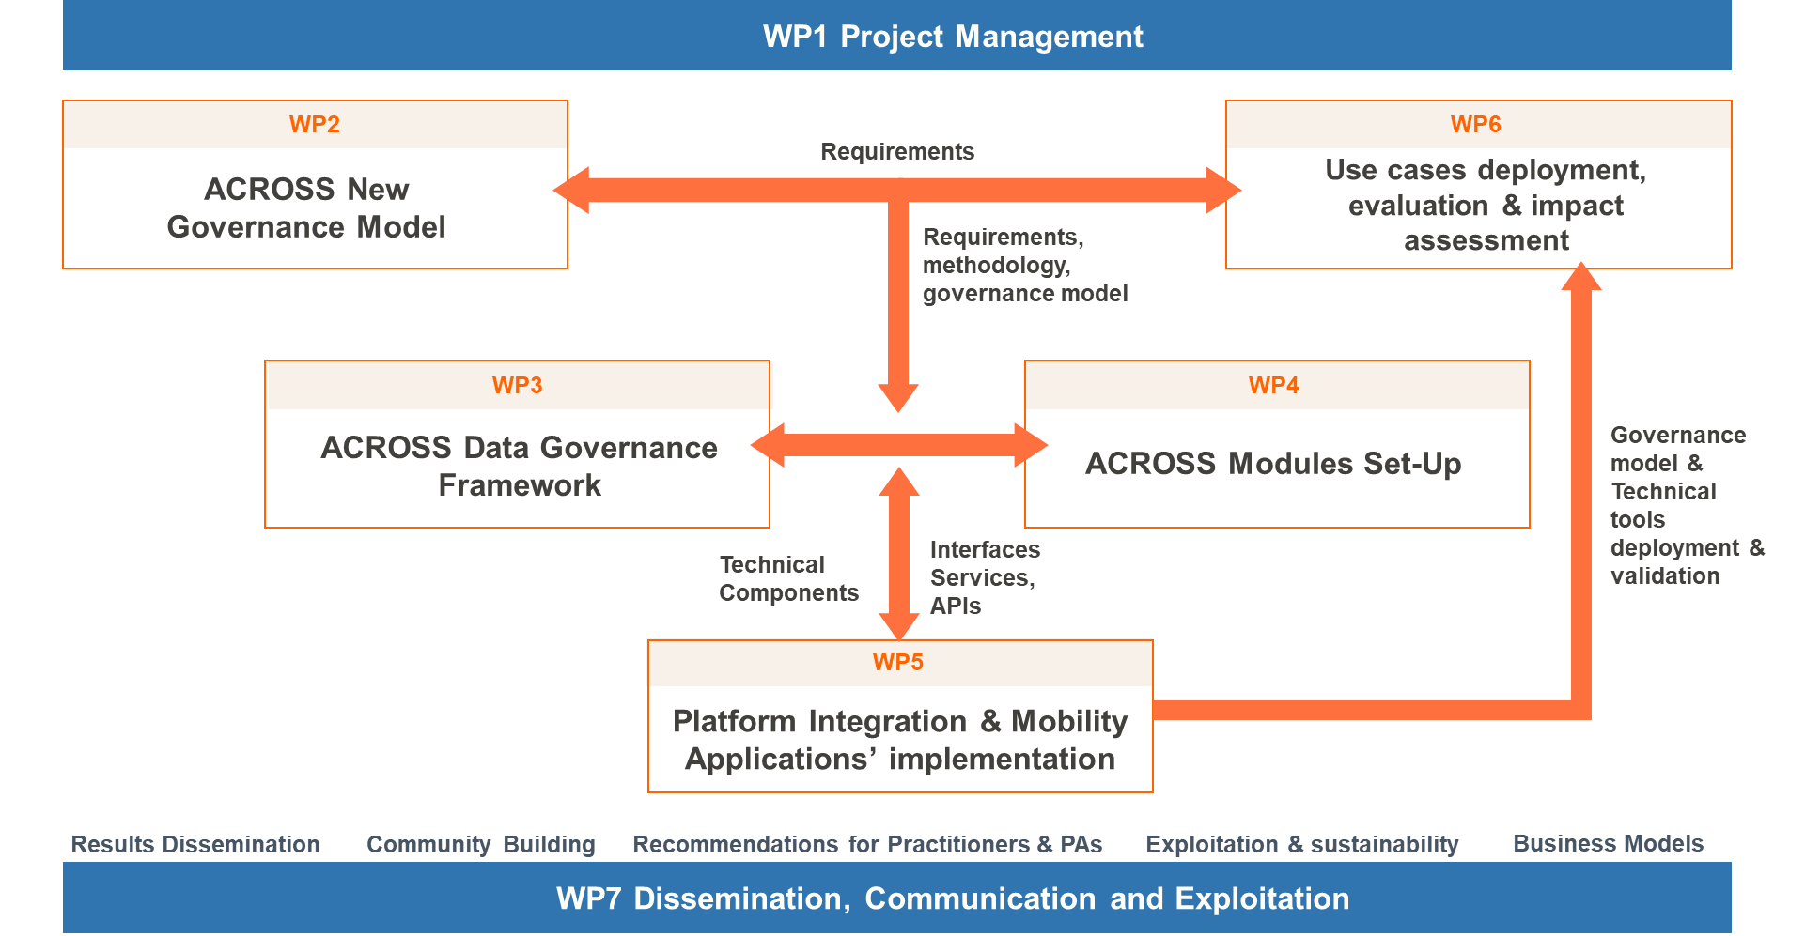
ACROSS PROJECT PRESENTATION
ACROSS work packages (WP)
This project has received funding from the European Union’s Horizon 2020 research and innovation programme under grant agreement No: 959157.

Slide 14
ACROSS
results and benefits

Slide 15
ACROSS PROJECT PRESENTATION
ACROSS key-results
KR6: ACROSS Ecosystem
KR1: A User journey methodology, approach and supporting tool
KR7: Data governance framework
KR2: Connectors and data harmonization tools
KR8: Co-design involving stakeholders to participate in the development and evaluation of public services.
KR3: Multi-lingual Virtual Assistant providing speech and textual chat interfaces
KR9: Impact analysis and lessons learned
KR4: ACROSS Platform, for cross-border seamless public service delivery
KR10: ACROSS Use cases implementation
KR5: Mobile and web application for one-stop-shop service delivery to facilitate citizen cross-border mobility
KR11: Business plan
This project has received funding from the European Union’s Horizon 2020 research and innovation programme under grant agreement No: 959157.

Slide 16
Meet the ACROSS team

Slide 17
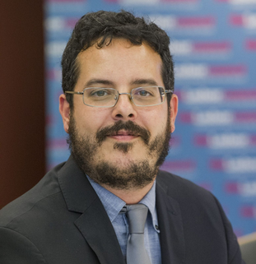
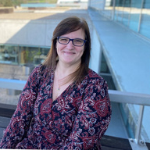
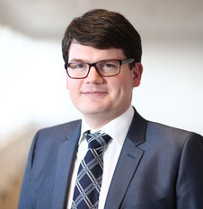
Anna Triantafillou
Robert Goené
Inese Viktorija Ilmere
Nathan Carvalho
Timo Behrmann
PROJECT COORDINATOR
WP2 LEADER
USE CASE ADVISOR
PROJECT MANAGER
USE CASE PROVIDER
Marina Klitsi
Sophie Almanza
Francesco Mureddu
Lutfi Samo
PROJECT MANAGER
PROJECT MANAGER
WP7 LEADER
PROJECT MANAGER
Anestis Sidiropoulos
Max Kortlander
Heinrich Hammerstein
WP5 LEADER
RESEARCHER & TASK LEAD
Enrique Areizaga
PROJECT MANAGER
PROJECT MANAGER
Stef van den Broek
David Britnell
COMMUNICATOR
Leire Orue-Echevarria
Nikos Vasilakis
DEVELOPER
TECHNICAL ADVISOR
USE CASE PROVIDER
WP6 LEADER
Leonard Langschwager
Vincenzo Savarino
PROJECT MANAGER
WP4 LEADER
Valentin Sanchez
WP3 LEADER
Roberto Di Bernardo
Thilo Ernst
Maitena Ilardia
Hans Graux
INNOVATION MANAGER
TECHNOLOGY PROVIDER
COMMUNICATION MANAGER
LEGAL FRAMEWORK LEADER
Alexandros Melidis
PROJECT MANAGER
This project has received funding from the European Union’s Horizon 2020 research and innovation programme under grant agreement No: 959157.

Slide 18
European Union’s Horizon 2020
SOCIAL MEDIA
CONTACT
WEBSITE
Anna Triantafillou
Email: a.triantafillou@atc.gr
Phone: +30 210 68 74 300
https://across-h2020.eu/
Twitter: @AcrossH2020
LinkedIn: ACROSS Project H2020

